Slide 1
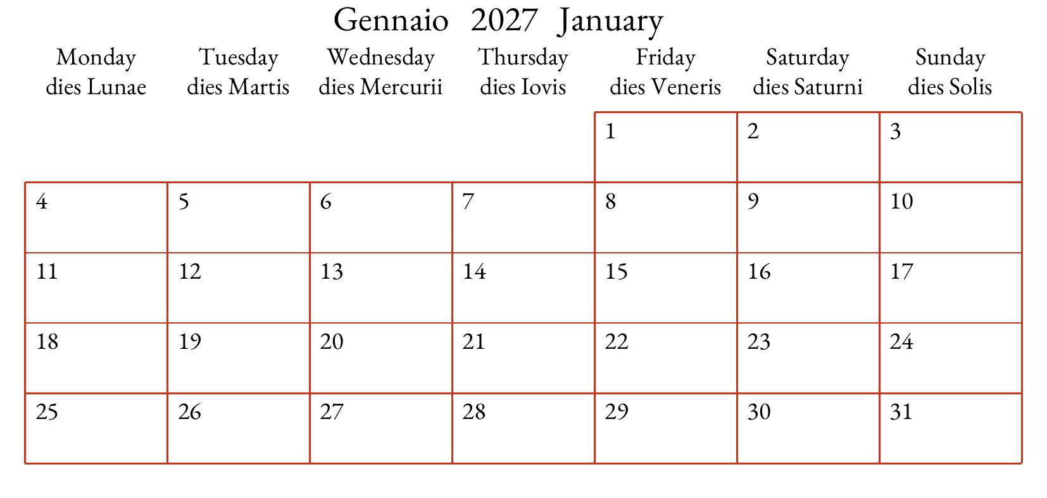
Title
T ext (place text in text frames )
and
Image(s)
.
Ling. Legend

