Slide 1
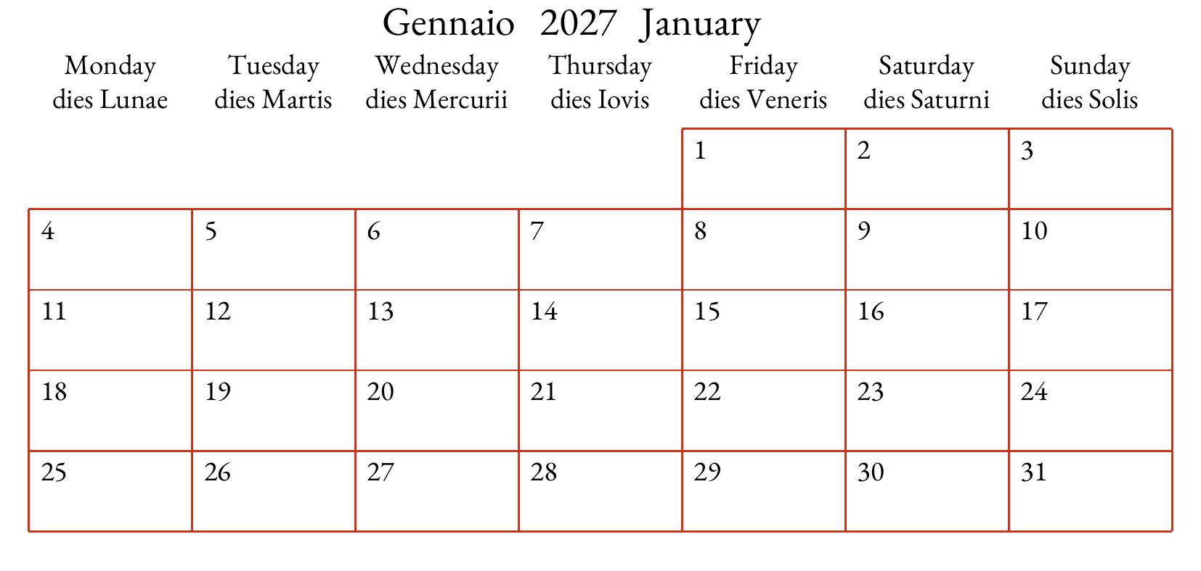
Title
The space btween the title bar and the calendar shown at the bottom
can be used for
- text ( < 500 chars !)
- image(s)
- a concise linguistic legend.
.
Ling. Legend

